Slide 1
LSTM – Long Short Term Memory
Sai Kiran 2024

Slide 2
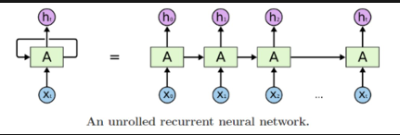
Why LSTM RNN?
RNN doesn’t solve long term dependencies, because of vanishing gradient Problem.
Consider your task is to generate the text .For Example, The task is we have filled the word for the sentence.
The colour of the sky is …… . To generate the word over there it is totally depended on the previous words here we won’t face the Vanishing gradient Problem as the length of the sentence is small.
Consider this Example, My name is Sai. I live in India. I reside in Chennai. I work in Private Sector. I speak fluent ….. . Here we have to generate the text that dependant on the previous context . Consider we have to fill the language over there, It is dependant on the context (Indian & Chennai) . Since the dependencies gap is very long, we may have vanishing dependency problem hence RNN can’t solve this problem.

Slide 3
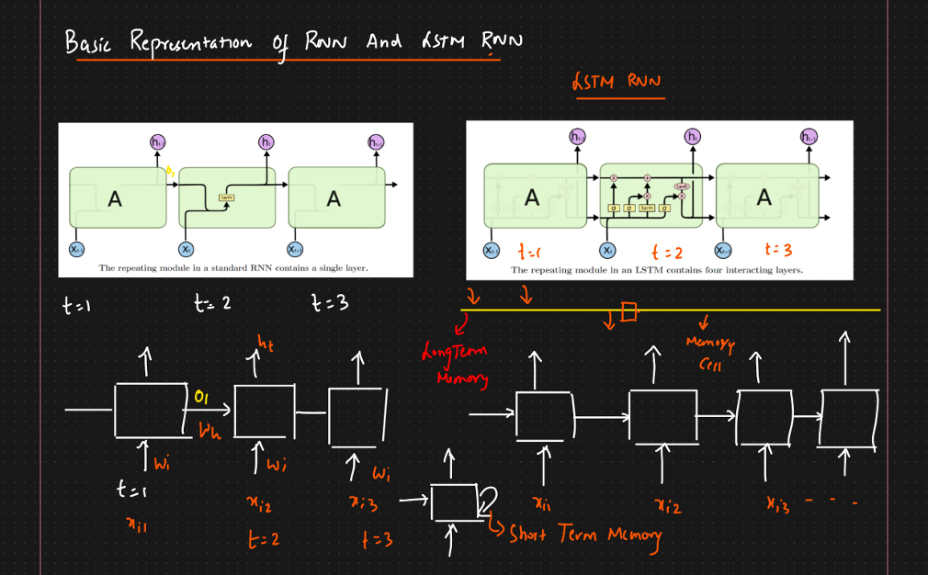
Basic Representation of RNN and LSTM

Slide 4
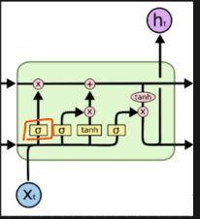
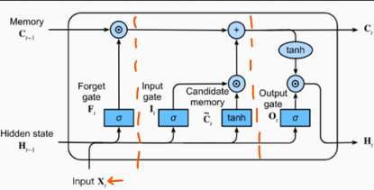

LSTM Architecture
For each layer we will have three gates in LSTM, They are called as Forget Gate, Input Gate & Memory Gate , Output Gate .
Components of LSTM Architecture:
Neural Network Layer basically means a hidden layer which has neurons and we have applied sigmoid activation function.
Point Wise Operation – We will see X, + , tanh operators . Here if we have two vectors we will apply that operators on the vectors and end up getting one vector
Vector Transfer – We transfer the vector from one gate to other gate
Concatenate – Combine the two vectors , It will be using during passing the vectors from current timestamp and previous timestamp to the hidden layer.
Copy Operator – If you want to make the duplicate copy of the vector

Slide 5
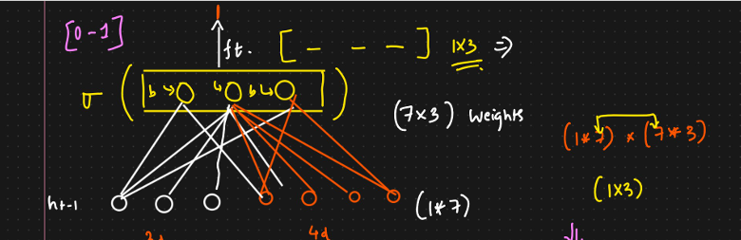
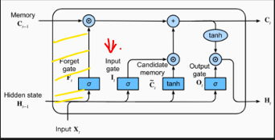
Forget gate
Consider I am doing the use case of next text generation
For Example:
Text Next Word
X11 X12 X13 y15 We will represent each word in 4 vectors like X11 = [0 2 4 1], X12 = [ 4 5 1 2]…
Consider xt = [0 2 4 1] and we will take hidden state ht-1 = [1 2 4] then ct-1 = [ 4 2 1] . Below Diagram explains why we get 3 dimension.

Slide 6
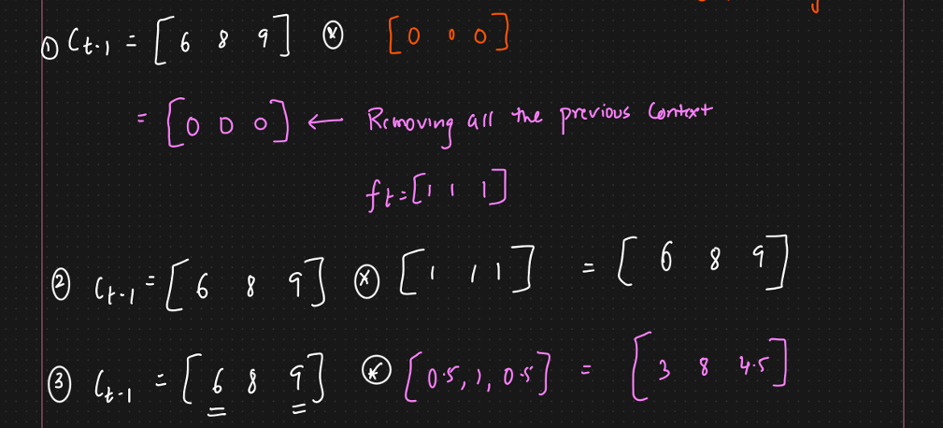
Forget gate
Next Step we will apply point wise operator, This operator will apply on the ct-1 (Previous memory cell) with the vector output from previous step.
Forget Gate will let go some information or all information based on the context

